Slide 1
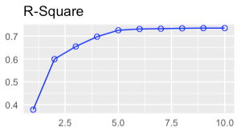
Asthma Attacks 3/6/2022
Project Authors | Kadie Iverson & Matt Donaldson
Industrial Area of Application | Medicine
Status | On Target
Project Description / Deliverables
Our data analytics project aims to predict the severity of an asthma attack and give recommendations on how the person should try and prevent future asthma attacks based on the 10 features in the data set. The data set used has a total of 1000 instances of asthma attacks from 10 participants. The input features looked at are gender, age, outdoor job, outdoor activity, if they smoke, humidity, temperature, pressure, UV index and wind speed. Ratings of the asthma attacks were recorded.
Deliverables:
Linear Regression model with Feature Selection and Cross-Validation
Random Forest model with Feature Selection and Cross-Validation
Model comparison
Rshiny feature
Descriptive Analytics:
Predictive Analytics: the final model
Prescriptive Analytics: based on the final model chosen, we can make suggestions on how to improve their life with asthma
Link to GitHub: https://github.com/donaldsonm731/Asthma_Prediction
Weekly Progress
Detected outliers using boxplots of continuous inputs against the categorical inputs, then determined an instance to be an outlier if it was deemed an outlier at least 2 times Used the “factor” function in R to change the categorical variables to create dichotomous variables for each possible value Performed Linear regression, and did an exhaustive search for best combination of features, using “ols_step_best_subset”, below is the a plot of the R^2 values produced by adding in the various variables Attempted PCA and Cross-Validation functions in R using ”train_control” and “train” from the caret package Began looking into Random Forest
Expected Business Value
Being able to narrow down factors that majorly contribute to asthma attacks, those with asthma attacks can make changes in their lives to minimize the risk of having an asthma attack.

